Slide 1
Deep Neural Networks
What does this
have to do with
the brain?

Slide 2
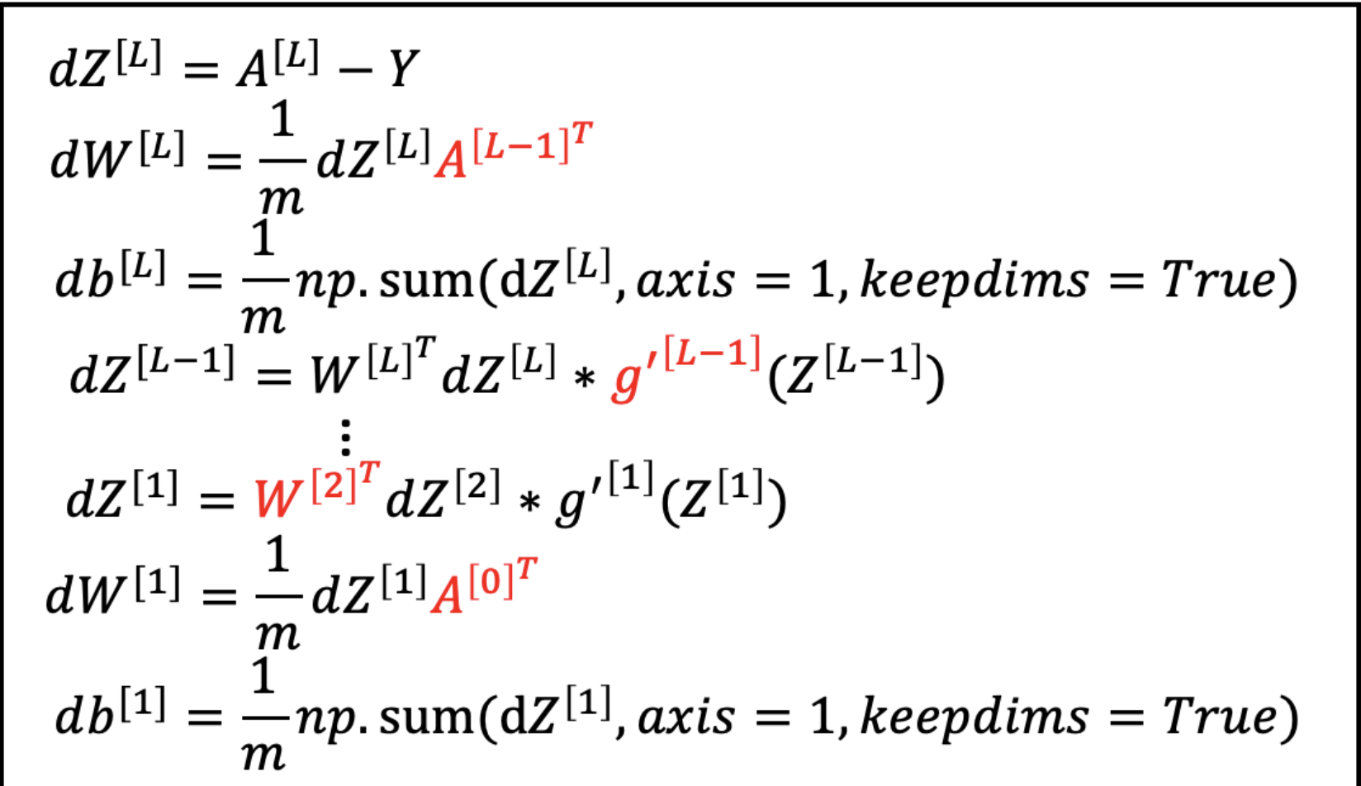

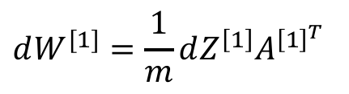
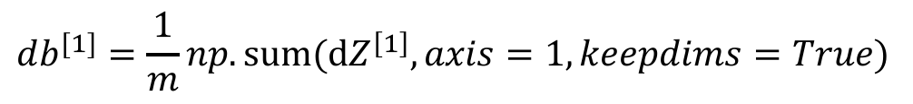

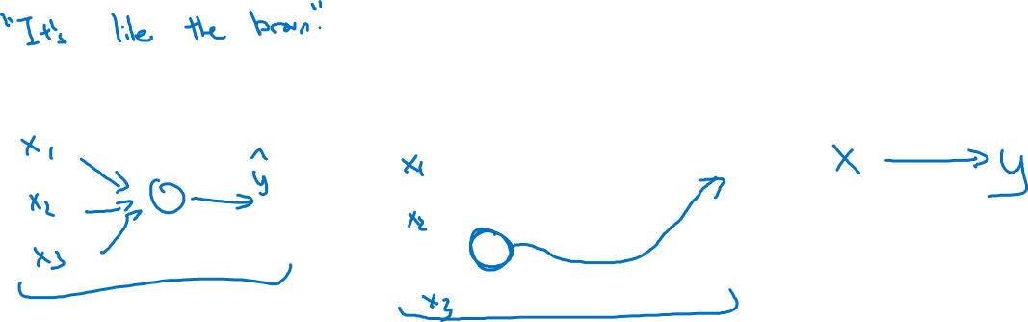






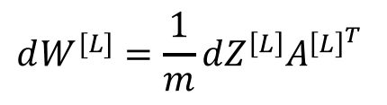
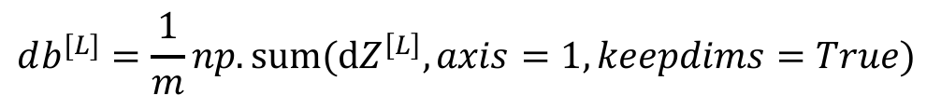
Forward and backward propagation
For example the first activation functions could be ReLU and the last one
Could be sigmoid
$$Z^{[1]}=W^{[1]}X+b^{[1]}$$
$${dZ}^{[L]}=A^{[L]}−Y$$
$$A^{[1]}=g^{\left[1\right]}(Z^{\left[1\right]})$$
$$dW^{[L]}=\frac{1}{m}dZ^{\left[L\right]}A^{{\left[L\right]}^{T}}$$
$$Z^{[2]}=W^{[2]}A^{[1]}+b^{[2]}$$
$$db^{[L]}=\frac{1}{m}np. sum(dZ^{\left[L\right]},axis=1, keepdims=True)$$
$$A^{[2]}=g^{\left[2\right]}(Z^{\left[2\right]})$$
…
$${dZ}^{[L−1]}=dW^{{\left[L\right]}^{T}}dZ^{\left[L\right]}{g^{′}}^{\left[L\right]}(Z^{\left[L−1\right]})$$
$$A^{[L]}=g^{\left[L\right]}\left(Z^{\left[L\right]}\right)=\hat{Y}$$
…
$${dZ}^{[1]}=dW^{{\left[L\right]}^{T}}dZ^{\left[2\right]}{g^{′}}^{\left[1\right]}(Z^{\left[1\right]})$$
$$dW^{[1]}=\frac{1}{m}dZ^{\left[1\right]}A^{{\left[1\right]}^{T}}$$
$$db^{[1]}=\frac{1}{m}np. sum(dZ^{\left[1\right]},axis=1, keepdims=True)$$
Align left/vertical will mess up the equations here

